Slide 1
C29PE Economics for Professionals
Week 7 – Governments and Markets
Sloman et al., 2023, Chapters 20 & 21

Slide 2
Session Aims
To understand the rationale for government intervention
To identify and discuss types of market failure and the relevant remedies
To differentiate the government intervention and market oriented approaches to remedy market failure

Slide 3
References
Sloman et al (2023)
  Chapter 20.1 – 20.3
  Boxes 20.1 – 20.3
  Chapter 21.1
  Box 21.1
Important!
  The PowerPoint slide deck for Week 7 lecture provides a guideline of the topics you need to know. However, the materials in the slide deck are insufficient if you wish to excel in the course
  To do well, please do not forget to read the relevant sections of the core textbook
  Please also ensure that you follow economics news regularly as these sources could be used as examples to supplement your answers during assessments

Slide 4
Markets and the Role of Government
“While I have been a lifelong capitalist, I could never accept the laissez-faire is a good solution for society. It was John Ralston Saul who said that ‘unregulated competition is just a naïve metaphor for anarchy’ – we don’t need that. What we need are regulated markets. And the challenge is to maximise our prosperity by finding the most efficient ways to regulate them.”
Neelie Kroes, European Competition Commissioner, ‘Competition, the crisis and the road to recovery’, Address at the Economic Club of Toronto, 30 March 2009
Why do we need the government to intervene in the activities of business?

Slide 5
Markets and the Role of Government
Although most countries today can be classified as ‘market economies’, governments still intervene substantially in the activities of business to protect the interest of consumers, workers and the environment.
For instance, firms might:
  Collude to fix prices
  Use misleading advertising
  Create pollution
  Produce unsafe products
  Use unacceptable employment practices
In such cases, government is expected to intervene to correct for failings of the market system.
However, unless government intervention is carefully designed, it can have unintended consequences. The ‘cure’ might be worse than the ‘disease’.

Slide 6
Markets and the Role of Government
Government intervention and social objectives
  To decide the optimum levels of government intervention, it is necessary to identify the various social goals that intervention is designed to meet.
  Two key objectives of govt. policy identified by economists are social efficiency & equity.
1. The objective of social efficiency
  Marginal social benefits and costs
    MSB > MSC → socially efficient to produce (or consume) more
    MSC > MSB → socially efficient to produce (or consume) less
    Socially efficient output where MSB = MSC
    For e.g., if people’s gains from having a high-speed railway, such as HS2 in the UK, exceed all the additional cost to society (both financial and non-financial) then it is socially efficient to construct the railway.
    Social efficiency is an e.g. of allocative efficiency, i.e. the best allocation of resources between alternative uses

Slide 7
Markets and the Role of Government
Government intervention and social objectives
2. The objective of equity
  Most people would argue that the free market fails to lead to a fair distribution of resources, if it results in some people living in great affluence while others live in extreme poverty.
  Concepts of fairness – what constitutes ‘fairness’ is a contentious issue
    Most people would argue however that the government does have some duty to redistribute incomes from the rich to the poor through the tax and benefit system, and perhaps to provide various forms of legal protection for the poor (such as the minimum wage rate).
  An equitable distribution is not the same as a totally equal distribution.
There may be trade-offs between equity and efficiency

Slide 8
Types of Market Failure
Market power
  Lack of social efficiency
    Whenever markets are imperfect, whether as pure monopoly or monopsony or whether as some form of imperfect competition, the market will fail to equate MSB and MSC
    Assume initially that all the costs and benefits to society accrue solely to the firm and its customers (we drop this assumption when we talk about externalities).
    This means that the firm’s MC = MSC and the price (AR), i.e. what consumers are willing to pay for one more unit is the MSB (AR = MSB)
    In the case of a monopoly, the firm will produce less than the socially efficient output.
    A monopoly faces a downward-sloping demand curve and therefore MR is below AR (MSB).
    Profits are maximised at an output of Q₁, where MR = MC.
    If there are no other sources of market failure, the socially efficient output will be at the higher level of Q₂, where MSB = MSC.
Notes:
7

Slide 9
A monopolist producing less than the social optimum
£
MC = MSC
P₁
P₂ = MSB
= MSC
MC₁
AR = MSB
MR
O
Q₁
Q₂
Q
Social optimum
Notes:
2

Slide 10
Types of Market Failure
Market power
  Consumer and producer surplus
    One way of analysing the welfare loss that occurs in any market is to use the concepts of consumer and producer surplus.
    consumer surplus from a good – the difference between the total utility (satisfaction) received by consumers and their total expenditure on the good.
      It can be thought of as the difference between the max. amount people are willing to pay for a good and the price they actually do pay.
    producer surplus – similar to profit. It is the difference between TR and TVC (it will be greater than profit if there are fixed costs).
      It can be thought of as the difference between the min. price required in order for a firm to supply a good and the price that is actually paid.
    total (private) surplus – total consumer plus producer surplus. The area between the demand and MC curves
Notes:
7

Slide 11
Types of Market Failure
Market power
  The effect of monopoly on total surplus
    When the industry is under monopoly, the firm will produce where MC = MR, at an output of Q_{m} and a price of P_{m} (at point b on the demand curve).
    TR is P_{m} x Q_{m} (areas 2 + 4 + 6).
    TC is the area under the MC curve (area 6). Thus producer surplus is areas 2 + 4.
    This is a larger surplus than under perfect competition (monopoly profits are larger than profits under PC)
    Consumer surplus, however, will be much smaller.
    With consumption at Q_{m}, total utility is given by areas 1 + 2 + 4 + 6, whereas consumer expenditure is given by areas 2 + 4 + 6. Consumer surplus, then, is simply area 1.
    Total surplus under monopoly is therefore areas 1 + 2 + 4: a small surplus than under PC.
    ‘Monopolisation’ of the industry has resulted in a loss of total surplus. The producer’s gain has been more than offset by the consumer’s loss.
    This loss of surplus is known as deadweight welfare loss of monopoly.
Notes:
7

Slide 12
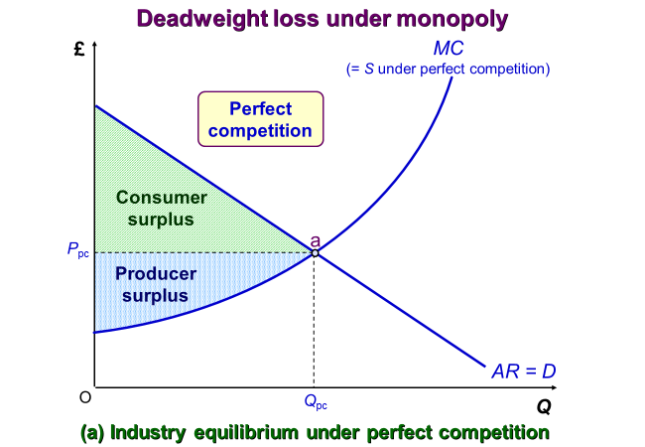
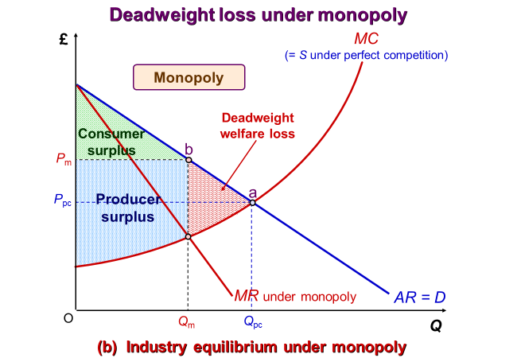
The effect of monopoly on total surplus
1
2
3
5
4
6
7

Slide 13
Types of Market Failure
Externalities
  Markets tend to work effectively when the benefits and costs to the consumers and producers directly involved in the transaction are the same as the benefits and costs to society.
  However, this may not always be the case. There may be benefits or costs to people other than the consumer or producer.
  If consumption and production do affect other people, the marginal social benefit (MSB) will be different from the marginal private benefit (MPB) and/or the marginal social cost (MSC) will be different from the marginal private cost (MPC).
  For e.g., imagine a situation where your consumption of a good (for e.g. using a mobile phone while driving) has either positive or negative impact on the people around you.
  In the phone example, it is the increased risk of an accident for other drivers.
  In other words, there are either external costs or benefits of your actions.
  Here, the full benefit to society from your consumption of the good are different from the private benefits that you receive.
Notes:
6

Slide 14
Types of Market Failure
Externalities (cont.)
  These external or ‘third-party’ effects from consumption are called consumption externalities.
  When we add consumption externalities to private benefits we get social benefits.
  Now imagine that you are the owner of a firm. Each unit you produce generates costs or benefits that are experienced by your firm.
  However, production may also generate benefits or costs for other people.
  Again, there are external benefits or costs, but this time from the firm’s actions.
  The full costs or benefits to society from the production of the good are, in this case, different from the private costs borne by the firm.
  These external effects of production are called production externalities.
  When we add production externalities to private costs we get social costs.
  In a market environment, without government intervention, where everyone is acting purely in their own interests, these external costs and benefits will not be taken in to account.
Notes:
6

Slide 15
Types of Market Failure
Externalities (cont.)
  We will now consider four different types of externality. Each one will be considered in isolation, although it would be possible to have more than one in any particular market.
  External costs of production (MEC_{P})
    For e.g., when firms in the chemical industry dump waste in a river or pollute the air
    The MSC of chemical production = MPC + MEC_{P}.
    Competitive market forces will lead to an equilibrium at point a, where demand (MPB) = supply (MPC)
    MSC > MPC: Q_{PC} > Q*
    External costs of production in a perfectly competitive market result in overproduction, i.e. Q_{pc} > Q*. From society’s point of view, too much waste is being dumped in rivers.
    ‘Missing market’ – no one has legal ownership of factors such as the air or rivers.
Notes:
6

Slide 16
Types of Market Failure
Externalities (cont.)
  External benefits of production (MEB_{P})
    If companies in the forestry industry plant new woodlands, there is a benefit not only to the companies themselves, but also to the world through a reduction of CO₂ in the air.
    We assume that the MEB_{p} begin with the first tree planted but that the marginal benefit declines with each additional tree – the MEB_{p} is a downward-sloping line
    MSC < MPC: Q_{PC} < Q*
    MSC = MPC – MEB_{p}
    From society’s point of view, not enough trees are being planted.
    The deadweight welfare loss caused by this underproduction is shown by the area ‘abc’
    Output is not being produced between Q_{pc} and Q* even MSB > MSC
Notes:
6

Slide 17
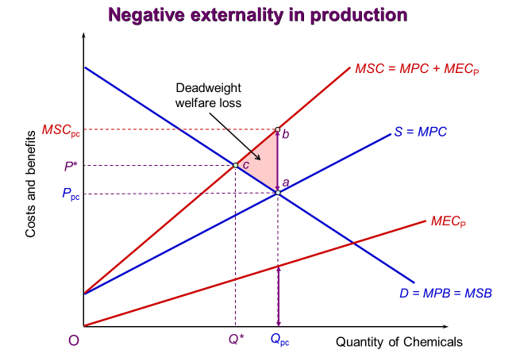
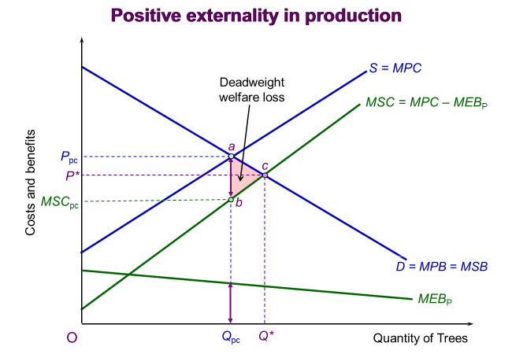
Externalities

Slide 18
Types of Market Failure
Externalities (cont.)
  External costs of consumption (MEC_{C})
    Drinking alcohol can sometimes lead to marginal external costs of consumption. For e.g., there are the extra nightly policing costs to deal with the increased chance of social disorder.
    Results in MSB < MPB: Q_{PC} > Q*
    The external costs of consumption result in level of output above socially efficient level, i.e. Q_{PC} > Q*
    From society’s point of view, too much alcohol is being produced and consumed.
  External benefits of consumption (MEB_{C})
    If people use the train to travel to the city centre or to football matches, then others benefit from less congestion and exhaust fumes
    MSB > MPB: Q_{PC} < Q* (results in a level of output below the socially efficient level)
    From society’s point of view, not enough journeys are being made on the train.
Notes:
6

Slide 19
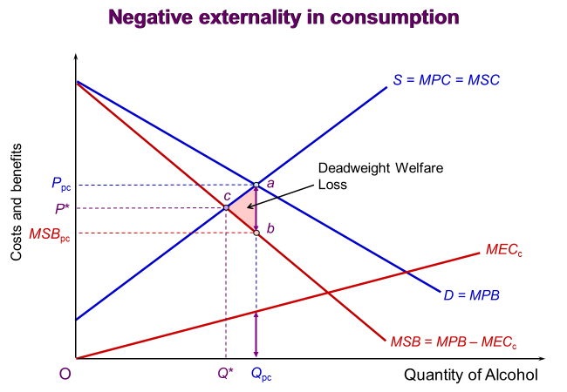
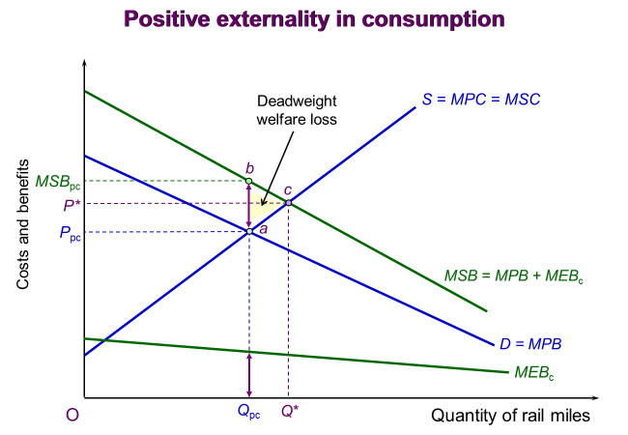
Externalities

Slide 20
Types of Market Failure
Public goods:
importance of two characteristics
  the degree of rivalry
    to what extent does consumption by one person prevent all other consumers from enjoying the good?
  the ease of excludability
    how easy is it to prevent non-payers from consuming the good?
Notes:
6

Slide 21
Types of Market Failure
Rivalry and excludability
Consider these four goods or services
  Supermarket food, the road network, music streaming, sunlight
Apply these two properties of goods and services:
  Rivalry: consumption by one person prevents other consumers from enjoying those units of a good or service
    The extent to which your consumption precludes my consumption
  Excludability: producers of the good can prevent non-payers from consuming units of the good or service
    The extent to which we have to compete for access to the good
Notes:
6

Slide 22
Types of Market Failure
Rivalry and excludability: examples
  Visit a supermarket, buy food
    Becomes your property, do what you wish with it (eat it, donate it to a food bank)
    rivalrous and excludable: private good
  Drive your car to campus arriving at 9am
    Plenty of other people have the same plan – so there is congestion
    Rivalrous (capacity constraint) but non-excludable: common good
  Music streaming (and downloads)
    Doesn’t matter how popular it is – buy access for a fee
    Excludable (members only), but non-rivalrous: club good
  Sunlight
    More in Dubai than in Edinburgh
    Non-excludable, non-rivalrous: public good
Notes:
6

Slide 23
Classifying goods according to the degree of rivalry
and ease of excludability
X
Y
High
In the examples, we have assumed that there is a simple classification
Makes more sense to think about the degree of rivalry
For e.g. roads are not busy for many hours of the day
Club good
Pure
private good
Impure
public good
Ease of excludability
E₁
W
Pure
public good
Common good
Low
Z
V
R₁
Low
Degree of rivalry
High
Notes:
23

Slide 24
The efficient level of output for a pure public good
Derivation of the market demand curve
    The market demand curve for a private good illustrates the sum of all quantities demanded by all consumers at each possible price. Different consumers will each want to purchase varying amounts at each price.
    These different individual demands at each price are simply added together in order to derive the market demand curve for a private good (horizontal aggregation or summation of individual demand curves)
    The market demand curve for a pure public good cannot be derived in the same way, because consumers are unable to purchase and consume different quantities of the good
    Once a given amount of a pure public good is produced for one customer, every other customer can consumer that same amount at no additional cost
    So, we have to add together the maximum amount each consumer is WTP for each possible level of output
    Simple example, assume there are only 2 consumers of the public good (many more in real world)
Notes:
6

Slide 25
The efficient output of a pure public good
The maximum amount Dean would be WTP to consume the 10th unit of the good is illustrated at point ‘a’ on his demand curve (D_{D}) and is £30
The maximum amount John would be WTP for the 10th unit of the good is illustrated at point ‘b’ on his demand curve (D_{J}) and is £50
If we add these WTP figures together, we obtain the MB to society from producing the 10th unit of the public good. This is illustrated at point ‘c’ and is £80
If we continue this exercise for each level of output, we can derive the MSB curve.
MSB = D_{D} + D_{J}. Vertical aggregation of the individual demand curves
160
100
D_{J}
Marginal benefit and marginal cost
80
c
MSB = D_{M}
= D_{D} + D_{J}
60
D_{D}
50
b
30
a
O
10
20
Quantity of the public good
Notes:
25

Slide 26
The efficient output of a pure public good
g
Producing a public good normally would have the same characteristics as producing a private good. Costs would vary with output in a similar manner.
The MC for the market would be derived by adding together quantities that each firm would want to supply at each price (same as for a private good).
The horizontal summation of all individual firms’ MC curves – hence, it is drawn as an upward-sloping line.
160
100
D_{J}
Marginal benefit and marginal cost
80
c
MSB = D_{M}
= D_{D} + D_{J}
60
D_{D}
50
b
MC = 2Q
32
f
30
a
e
The socially efficient quantity can be found where MC = MSB (point ‘f’)
20
12
h
d
O
10
16
20
Quantity of the public good
Notes:
26

Slide 27
Free-rider problem
  Assume a private firm produced 16 units of the good and charged Jon a price of £20 per unit and Dean £12 per unit. These prices would equal their maximum WTP for 16 units.
  If Jon acts in a perfectly rational and selfish manner, we predict that he will not pay for the good
  Why? Because once the 16 units are produced, he can consume them whether he has paid for them or not.
  He acts as a free-rider by enjoying the benefits of a good that have been paid for by Dean.
  However, if Dean thinks the same way, he will not pay either.
  The firm will not generate any revenue and quickly go out of business – both Dean and Jon are worse off
  Because, of the free-riding problem, firms cannot produce goods and make a profit in a private market. If they charge a price they are, in effect, asking for a voluntary contribution
  If no voluntary contributions are forthcoming, then the good will not be provided.
  Could group work at university lead to free-riding?
Notes:
6

Slide 28
Types of Market Failure
Ignorance and uncertainty
  Perfect competition assumes that consumers, firms and factor supplies have perfect knowledge of costs and benefits.
  In the real world, there is often a lot of uncertainty – people are unable to equate MB with MC
  Asymmetric information
    Different sides in an economic relationship have different amounts of information
  Immobility of factors and time lags
    Even under conditions of perfect competition, factors may be very slow to respond to changes in demand and supply, for e.g. labour may be highly immobile. Results in constant disequilibrium.
  Protecting people’s interests
    Dependants – protecting the interests of those whose welfare depends on choices made by others
    Merit goods – protecting people from poor economic decisions that they make on their own behalf.
Notes:
7

Slide 29
Government Intervention in the Market
There are several policy instruments govt. can use to deal with the problems of the free market.
On the one extreme, it can totally replace the market by providing goods and services itself. At the other, it can persuade producers, consumers or workers to act differently.
Taxes and subsidies
  to correct for monopoly (excessive profits or production lower than socially efficient level)
    use of lump-sum taxes (increase FC) plus subsidies (encourage monopolist to produce more)
  to correct externalities
    Pigouvian tax/subsidy - impose a tax equal to the MEC (or grant a subsidy equal to the MEB)
Notes:
8

Slide 30
Government Intervention in the Market
Taxes and subsidies
  Advantages of taxes and subsidies
    Still allow the market to operate
    Adjustable - can vary the rate according to the size of the market distortion
    Long-run incentives – taxes can act as an incentive over the long run to reduce pollution and similarly, when good practices are subsidised, firms are given the incentive to adopt more good practices.
  Disadvantages of taxes and subsidies
    Infeasible to use different tax and subsidy rates – each firm produces different levels and types of externality and operates under different degrees of imperfect competition.
      It would be expensive and administratively very difficult to charge offending firms their own tax rate
    Lack of knowledge – difficult to measure the firm’s MEC and apportion blame
      It is possible though to charge firms by amount of a particular emission e.g. chimney smoke
Notes:
8

Slide 31
Government Intervention in the Market
Changes in property rights
  the problem of limited property rights – if someone dumps a load of rubble in your garden, you can insist that it is removed. If someone dumps a load of rubble in their own garden, which is next door to you and causes an eyesore, you can’t do anything about it.
  extending property rights – property rights define who owns property, to what uses it can be put, the rights people have over it & how it may be transferred. By extending these rights, individuals may be able to prevent other people imposing costs on them or charge them for doing so.
    the Coase theorem – when there are well-defined property rights and zero bargaining costs, then negotiations between the party creating the externality and the party affected by the externality can bring about the socially efficient market quantity.
    For e.g., in the case of river pollution by a chemical works (that imposes a cost on people fishing in the river), property rights to the river could be given to the fishing community and they could impose a charge on the chemical works per unit of output. (Or property rights could be given to the chemical works and the fishing community could offer them payments conditional on no polluting)
Notes:
9

Slide 32
Government Intervention in the Market
Changes in property rights
  Limitations of this solution
    Impractical in many situations – it is impractical when many people are slightly inconvenienced, especially if there are many culprits imposing the costs.
      For e.g. if I was disturbed by noisy lorries outside my home, it would be impractical to negotiate with every haulage company involved.
    Problems of litigation – may have to incur the time and expense of taking people to court
      Justice may not be free and there is a conflict with equity (the ‘rich’ can afford ‘better’ justice)
    Questions of equity – although the socially efficient outcome does not depend on who the property rights are assigned to, the equity of the outcome will
      The extension of private property rights may favour the rich (who tend to have more property) at the expense of the poor.
Notes:
9

Slide 33
Government Intervention in the Market
Laws prohibiting or regulating undesirable structures or behaviour
  Advantages of legal restrictions
    Usually simple and clear to understand and often relatively easy to administer
    When the danger is very great, it might be much safer to ban various practices altogether
    When a decision needs to be taken quickly, it might be possible to invoke emergency action
    Because consumers suffer from imperfect information, consumer protection laws can make it illegal for firms to sell shoddy or unsafe goods, or to make false or misleading claims about their products.
  Disadvantages of legal restrictions
    The main problem is that legal restrictions tend to be a rather blunt weapon.
      If, for e.g., a firm were required to reduce the effluent of a toxic chemical to 20 tonnes per week, there would be no incentive for the firm to further reduce it (unlike with a tax system).
Notes:
9

Slide 34
Government Intervention in the Market
Regulatory bodies
  Rather than using the blunt weapon of general legislation to ban or restrict various activities, a more ‘subtle’ approach can be adopted.
  Having identified possible cases where action might be required (e.g. potential cases of pollution, misleading information or the abuse of monopoly power), the regulatory body would investigate.
  Regulatory bodies for privatised utilities
    Ofgem (the Office of Gas and Electricity Markets, Ofwat (the Office of Water Services), etc
  Competition and Markets Authority
  Advantage of this approach – a case-by-case method can be used, and the most appropriate solution adopted
  Disadvantages of this approach – investigations may be expensive and time-consuming; only a few cases may be examined; offending firms may make promises of good behaviour but may not carry them out unless follow ups are done.
Notes:
9

Slide 35
Government Intervention in the Market
Price controls can be used to either raise prices above, or to reduce them below, the free-market leve
Prices set below the market equilibrium – the government, or another body, could set prices below the market equilibrium to prevent a monopoly or oligopoly from charging prices above the socially efficient level
  For e.g. Ofgem use price caps on energy bills
  For e.g. interest rate cap of 0.8 per cent per day applied to the payday loan market in January 2015
Prices set above the market equilibrium – the government could set prices above the competitive market equilibrium to reduce the level of social inefficiency caused by a negative externality and/or poor economic decision making by individuals on their own behalf.
  An efficient outcome would be reached if a minimum price was set at a level where the MSB = MSC
  For e.g. decision by the Scottish Government to introduce minimum unit pricing for alcohol in May 2018
  High farm prices can be used to protect the incomes of farmers and minimum wage legislation can help those on low incomes.
Price controls can cause shortages and surpluses
Notes:
10

Slide 36
Government Intervention in the Market
Provision of information
When ignorance is a reason for market failure, the direct provision of information by the government or one of its agencies may help to correct that failure.
    For e.g. the information on jobs provided by job centres to those looking for work.
    For e.g. the provision of consumer information, for instance on the effects of smoking or eating certain foodstuffs.
    For e.g. the provision of government statistics on prices, costs, employment, sales trends – this enables firms to plan with greater certainty.
Direct provision of goods and services
In the case of public goods and services, such as flood defence and national defence, the market mechanism may fail to provide the socially efficient amount because of free-riding.
Governments may have to finance the optimal provision of public goods by requiring compulsory payments from members of society (for e.g. through the tax system).
The government could also provide goods and services directly which are not public goods. Examples include healthcare and education.
Notes:
10

Slide 37
Government Intervention in the Market
  There are four reasons why some goods and services (other than public goods) are provided free or well below cost.
  1. Social justice
    Society may feel that these things should not be provided according to ability to pay. Rather they should be provided as of right: an equal right based on need.
  2. Large positive externalities
    People other than the consumer may benefit substantially. If a person decides to get treatment for an infectious disease, other people benefit by not being infected.
    A free health service helps to combat the spread of disease.
  3. Dependants
    If education were not free and if the quality of education depended on the amount spent, and if parents could choose how much or little to buy, then the quality of children’s education would depend not just on their parent’s income, but also on how much they cared.
  4. Ignorance
    Consumers may not realise how much they will benefit. If they have to pay, they may choose (unwisely) to go without.
Notes:
10

Slide 38
The Case for Laissez-faire
The problems created by intervention can be greater than the problems overcome by that intervention
Drawbacks of government intervention
  Shortages (if price is fixed below the equilibrium, e.g. council housing) and surpluses (if price is fixed above the equilibrium, e.g. food prices)
  Poor information – the government may not know the full benefits and costs of its policies
  Bureaucracy and inefficiency – intervention involves administrative costs
  Lack of market incentives – the market may be imperfect but tends to encourage efficiency. For e.g. subsidies may allow inefficient firms to survive. Welfare payments may discourage effort.
  Shifts in government policy – difficult from firms to plan if they cannot predict tax rates, subsidies, price and wage controls, etc.
  Lack of freedom for the individual – intervention involves a loss of freedom for individuals
  Voters’ ignorance, Unrepresentative government
Notes:
15

Slide 39
The Case for Laissez-faire
Advantages of the free market
  automatic adjustments - leads to automatic adjustment to supply and demand changes
  dynamic advantages of capitalism – the chances of making high monopoly/oligopoly profits will encourage entrepreneurs to invest in new products and techniques.
  high degree of competition even under monopoly/oligopoly
    possible market contestability – creates fear those earning high profits
    competition from other closely related industries, e.g. electricity for gas, coach for rail
    threat of competition from abroad
    countervailing powers – large powerful producers often sell to large powerful buyers, so to some extent power is neutralised
    competition for corporate control – potential for takeovers bids if firm runs inefficiently
Judging the arguments
Notes:
16

Slide 40
Additional slides for reading (will not be covered during session)

Slide 41
Firms and Social Responsibility
Traditional economic theory assumes that firms are trying to maximise profits and are not concerned with the impact of their activities on the wider community.
However, many of the most famous companies in the world are now regularly publishing reports outlining their progress towards achieving broader societal goals.
  For e.g. Google issues an Environmental Report, BMW produces a Sustainable Value Report
Meaning of corporate social responsibility (CSR) – where a business integrates social, environmental, ethical and human rights concerns into its actions in close collaboration with stakeholders.

Slide 42
Firms and Social Responsibility
Types of CSR activities – most of the activities undertaken by firms can be grouped:
  Environmental activities
    Includes policies to use energy more efficiently, reduce wastage, increase recycling, increase the use of energy from renewable resources and reduce CO₂ emissions
  Donating money/equipment/employees’ time to charities etc.
    Research by the Charities Aid Foundation found that FTSE 100 companies donated £1.9bn to charities in 2016 (however, these donations have been falling over time)
  Fair and ethical treatment of employees
    E.g. paying ‘fair’ wages, reducing gender pay gap, employing more people from ethnic minorities, increasing % of female senior managers, offering more generous maternity leave
  Fair and ethical treatment of suppliers
    E.g. negotiating ‘fair’ contracts with suppliers, only dealing with suppliers who meet CSR benchmarks

Slide 43
Firms and Social Responsibility
Benabou & Tirole (2010) discuss three different visions of CSR
  Insider-initiated philanthropy or the classical view
    Business managers should be solely concerned with trying to maximise profits
    Milton Friedman: ‘The social responsibility of business is to increase profits.’
  Delegated philanthropy
    Interests of different stakeholders – preferences may not align with government policy
    How can different primary stakeholders pay to interact with firms who invest in CSR?
      Investors – are some people willing to accept lower expected returns from investments in businesses that spend large amounts on CSR?
      Customers – are customers willing to pay higher prices for goods from these firms?
      Employees – are employees willing to accept lower wages to work for these firms?
      Other stakeholders – social norms of what’s regarded as ‘acceptable’ corporate behaviour
Notes:
16

Slide 44

Pressures on companies to be more socially responsible
Primary stakeholders’ concerns
Owners
  Effect on profit of company image
  Sustainability of production
  Ethical investment and effects on share value
Employees
  Pay
  Conditions
  Fair treatment
Consumers
  Green / ethical products
  Behaviour of company
  Fair treatment of workers
Other firms (suppliers & customers)
  Fair trade
  Ethical values and behaviour
Impact of secondary stakeholders
Government and regulators
  Green taxes
  Laws and regulation
  Auditing
  Political pressure
  Local government controls
Communities
  Local action groups
  Chambers of commerce
  Special interest groups
Other organisations
  Trade associations
  Trade unions
  Green groups
  Charities
  International bodies (e.g. WTO)
Social / ethical / institutional pressures
Changes to the civil foundation
  Business ethics
  Social norms and public expectations
  Attitudes towards the environment
Public information
  Rankings in lists according to CSR
  Media reports
  Education
Public demands
  For high ethical / social / environmental standards
  Accountability and transparency

Slide 45
Firms and Social Responsibility
Benabou & Tirole (2010) discuss three different visions of CSR
  Overcoming short-termism view
    This view is based on the premise that companies suffer from short-term bias. In particular, managers often take decisions to try and maximise short-run profits at the expense of returns in the long-run.
    For e.g. they may try to circumvent government regulations – this may reduce more immediate costs but lead to lower profits in the long-run.
    A well-known case is that of Volkswagen – in 2015, it admitted that it had loaded illegal software to around 11million of its diesel cars worldwide (to reduce emissions readings).
    Putting value on CSR may help to overcome this short-term bias and maximise the value of its profits in the long run.
    A slightly different standpoint is to view CSR as a strategic move, which attempts to improve the firm’s competitive position in the long run.
Notes:
16

Slide 46
Firms and Social Responsibility
The impact of CSR on economic performance
  A number of studies have attempted to measure the impact on firms’ profits of investing in CSR - results have been mixed, finding +ve impacts, -ve impacts and no relationship.
  There are a number of reasons the results have been so mixed:
    Difficulties in trying to define and measure CSR – much of the info needed to measure CSR is non-financial and not reported in a standardised way.
    Difficulties in trying to measure firms’ performance – the concept of profitability is contentious, in respect to the time frame over which assessment takes place. How do you attribute a given % or contribution to profit to the adoption of a more socially responsible business position?
    The simultaneous impact of a mix of different motives

Slide 47
Competition Policy
Competition, market power and the public interest
  Not necessarily the case that market power is always ‘a bad thing’ as far consumers concerned
  The question is whether it is abused
  Most countries prefer to focus on whether the practices of particular monopolists or oligopolists are anti-competitive
The targets of policy – three broad areas of competition policy
  1. Abuse of existing power of monopolies and oligopolies: monopoly policy
  2. The growth of market power through mergers and acquisitions: merger policy
  3. Collusion: restrictive practice policy
Primary responsibility for enforcing competition law lies with Competition & Markets Authority (CMA)

Slide 48
Competition Policy
1. Tackling the abuse of the existing monopolies and oligopolies: monopoly policy
  The competition agencies usually weigh up gains and losses to public of the firm’s behaviour
  Exploitative abuse – a business practice that directly harms the customer
    E.g. charging a higher price, producing a lower output, reductions in product quality, limited product ranges, poor levels of customer service
    Regulatory authorities/governments have tended to avoid investigating allegations of exploitative abuses because of the challenges involved in accurately identifying and correcting for this type of behaviour
    E.g. measuring the mark up of price over costs is very difficult in reality
    Therefore, price regulation tends to be left to cases of natural monopoly (i.e. the privatised utilities), which have specific regulators.
    So, competition policies tend to focus on investigating allegations of exclusionary abuses

Slide 49
Competition Policy
  Exclusionary abuse
    exclusivity rebates/discounts – customers are offered special deals if they agree to make ‘all or most’ of their purchases of the product from a dominant firm.
    Tying – this is where the firm controlling the supply of a first product (the tying product) insists that its customers buy a second product (the tied product) from it rather than from its rivals.
      E.g. Microsoft’s decision to include its media player and Web browser with the sale of its Windows operating system. Deemed an abuse of market power.
    Predatory pricing – prices are set by a dominant firm below its AVC (with intention of driving rivals out of business)
    Refusal to supply and margin squeeze – firm is dominant in an upstream market but faces competition in later stages (e.g. assembly). Charges high prices/refuses to supply inputs
    Vertical restraints – supplying firm imposes conditions on a purchasing firm (or vice versa)

Slide 50
Competition Policy
2. The growth of market power through M&As: merger policy
  In many cases, M&As are beneficial to consumers and the economy as the newly combined firms can rationalise (reorganise to increase operating efficiency) and reduce costs.
  However, M&As can reduce in significant reductions in competition.
  Most competition authorities carry out a relatively quick initial review of M&As and clear the majority of cases where the impact of competition is judged to be negligible.
  When the potential impact on competition is more serious, the authorities carry out a more detailed investigation to see whether the potential benefits of the merger outweigh the costs.
  In only a few cases, the M&A is prohibited.

Slide 51
Competition Policy
3. Oligopolistic collusion: restrictive practice policy
  Practices that are the target of policy
    Horizontal price fixing – direct or indirect agreements between rival firms to fix prices above competitive levels.
      E.g. adhering to a published price list, charging customers same amount for delivery
    Market sharing – agreements on how to distribute markets or customers between the firms.
      This could be done by geographical area, type of product or type of customer
    Limiting production: e.g. quotas for individual firms – firms agree quotas on how much each firm should produce.
    Bid rigging – in response to a call for tenders, firms agree to discuss bids with one another rather than submitting them independently.
      One or more may agree not to submit a bid, withdraw a bid or submit a bid at a high price
    Information sharing – firms share sensitive information with one another, such as future plans on pricing, product design or output.

Slide 52
Competition Policy
  Examples
    https://www.gov.uk/government/collections/business-cartels-case-studies
    Dar Lighting fined £1.5m for illegally preventing online price discounts
    Breaking competition law: construction cartel in groundworks
    Private healthcare provider fixed prices with consultants
    Why we fined Casio £3.7m for breaking competition law

Slide 53
Competition Policy in the EU
EU restrictive practices policy: Article 101 − focus on behaviour
  Covers agreements between firms, joint decisions and concerted practices that prevent, restrict or distort competition
    i.e., all types of oligopolistic collusion that are judged to be against the interests of consumers
    Designed to prevent collusive behaviour not oligopolistic structures
  Size of the basic fine depends on:
    percentage of relevant sales (size of its annual sales affected by anti-competitive activities)
    market share of participating firms and geographical area of affected sales
    duration multiplier: length of time firm has engaged in anti-competitive practices
    whether it is guilty of engaging in such practices in the past
    whether it initiated the cartel: i.e., been the ringleader
    Fines are capped to 10% of annual turnover

Slide 54
Competition Policy in the EU
EU restrictive practices policy: Article 101 − focus on behaviour
  Reductions can be made through co-operation with Commission
    The size of the initial or basic fine can be reduced if members of a cartel provide information that helps the Commission with its investigations – such firms would be granted a ‘Leniency Notice’.
    To qualify, they have to provide information about cartel meetings and details of how the anti-competitive practices operated.
    The first company to supply this type of information can be granted full immunity (Type 1A leniency) if its co-operation brings the case to the Commission’s attention.
    If the case is already being investigated, the first company to provide detailed information could possibly receive full immunity at the discretion of the Commission (Type 1B leniency)
    Other companies supplying information can be given reduced fines (Type 2 leniency)
    Further 10% reduction if firms accept Commission’s decision and the financial penalties imposed on them.

Slide 55
Competition Policy in the EU
EU monopoly policy: Article 102 − also focuses on behaviour
  Article 102 relates to the abuse of market power & has also been extended to cover mergers
  First, the European Commission (EC) has to define the relevant market
    i.e., identify which products and suppliers are close substitutes for one another.
    It has to decide if the firm has a dominant position in the market by looking at factors such as market shares, the position of competitors, the bargaining strength of customers, etc.
  Second, if the evidence confirms that the firm does have a dominant position, the EC then assesses whether the firm is using its market power to restrict competition.
  Practices can be banned, and firms fined
  The business must prove that its conduct meets the following conditions:
    any efficiencies are the direct result of the exclusionary conduct
    the same efficiencies could not be achieved by the firm being less anti-competitive
    the efficiencies produced outweigh any of its negative effects
    the conduct does not result in removal of competition in the market

Slide 56
Competition Policy in the EU
EU merger policy: 2004 regulations
  Prohibited if they would significantly impede competition in the EU
    This could occur through individual dominance (the M&A leads to a strengthening in the market power of one firm) or through collective dominance (the reduction in the number of firms following the M&A makes collusion likely)
  Criteria use to assess if the merger is
    Large: turnover thresholds – combined and individual sales thresholds
    Has an ‘EU dimension’ – sales value in Member states
  Notification of a merger intention followed by preliminary investigation by the EC (Phase 1)
    Over 90% are usually settled and the merger’s allowed to proceed (conditionally or unconditionally)
  In some cases, a more in-depth investigation is required (Phase 2)
  Assessment of the process
    EC too lenient? Since 1990, over 6800 mergers have been notified, but only around 250 referred to Phase 2 and only 27 had been prohibited (as of January 2018)

Slide 57
Competition Policy in the UK
UK competition policy
  The 1998 Competition Act brought UK in line with EU policy. The Act has two key sets (or ‘chapters’) of prohibitions
    Chapter 1 mirrors Article 101
    Chapter 2 mirrors Article 102
  2002 Enterprise Act and 2013 Enterprise and Regulatory Reform Act also influence the current approach
  Competition and Markets Authority (CMA) established in 2014 to replace the OFT and the CC

Slide 58
Competition Policy in the UK
UK restrictive practices policy
  1998 Act – fines calculated and implemented in a similar way to the EU
    Penalties up to 10% of a firm’s turnover
    Type A, B and C immunity (corresponding to Type 1A, 1B and 2 in EU)
  2002 Act – biggest different created in 2002 Enterprise Act: a criminal offence to engage in cartel agreements in UK
    Only two successful prosecutions between 2002 and 2017
    Authorities have found the policy difficult to implement
  2013 Act – made legal amendments to try to make it easier to bring successful prosecutions

Slide 59
Competition Policy in the UK
UK monopoly policy
  Two stage process (in line with Article 102 of EU policy)
    Does a firm have a position of dominance?
      does it have a market share ≥ 40%?
      problems of defining the market
      are there significant barriers to entry?
    If yes, then do the firm’s practices constitute an abuse of its position of dominance?
  In 2016, the CMA judged that the pharmaceutical manufacturer Pfizer and distributor Flyn Pharma were guilty of charging excessive and unfair prices for an anti-epilepsy drug.
    In 2012, the price of a 100mg packet of these tablets was increased from £2.83 to £67.50!
    The CMA imposed a record high fine on Pfizer of £84.2 million.

Slide 60
Competition Policy in the UK
UK merger policy
  Framework set out in 2002 Enterprise Act
  No requirement for firms to pre-notify the CMA (differs from EU policy)
  Investigation by CMA based on
    turnover test (≥ £70m)
    market share test (≥ 25%)
    Phase 1 and Phase 2 of the process
  Assessment based solely on competition – M&As can be prevented if they are likely to result in a ‘substantial lessening of competition’
  Final judgement:
    is left to the CMA (apart from in exceptional cases when a minister can intervene)
    unconditional clearance of merger
    conditional clearance of merger: firms have to take certain actions
    prohibition of merger (in 2017/18 only 10 mergers were prohibited out of 142 Phase 2 investigations)

Slide 61
Competition Policy: Comparative Assessment
Assessment of EU and UK policy
  Agreement that focus of monopoly policy should be on anti-competitive practices and their effects rather than simply on the existence of market dominance
    Economic power is only a problem when it is abused
    If market power enables firms to achieve economies of scale or more finance for investment, the result can be of benefit to customers
  Merger policy remains the most controversial area – claims that it is too lenient
  Specific issues with UK merger policy include:
    Criteria – broad ‘public interest’ v. ‘substantial lessening of competition’
    The lack of any requirement for firms to pre-notify authorities about a proposed merger

Slide 62
Competition Policy: Comparative Assessment
Effects of Brexit on alignment of UK with EU policy
  Since Brexit, under the terms of the UK-EU trade agreements, EU competition law is no longer enforced in the UK, and the UK and EU now operate separate competition regimes
  The CMA is now responsible for all anti-competitive practices that affect UK markets and consumers.
  Changes to the UK merger control regime
    An uplift in the "turnover test" threshold for UK merger control jurisdiction, from the current >£70million of turnover in the UK, to >£100 million.
    A new jurisdictional threshold, aimed at "killer acquisitions" (purchases intended to stifle emerging or potential competition). This will apply where one party has both: (a) a share of supply in the UK (or part of it) of 33% or more, and (b) UK turnover of £350 million or more.
    Some larger businesses will have to notify every acquisition to the CMA.

Slide 63
Competition Policy: Comparative Assessment
Other proposed reforms to UK competition law
  Increased penalties
    For non-compliance with formal CMA information requests, or providing mis-leading info
    Civil penalties for firms which breach commitments, directions, orders or interim measures
  Extending the reach of the CMA in enforcing UK competition law
    includes those agreements, practices & decisions implemented outside UK but impacting UK
  Raising the threshold for appealing against CMA interim measures
  New evidence gathering powers
    Greater powers to interview individuals in Competition Act investigations
  Reducing the turnover threshold for immunity for immunity from penalties
    Companies abusing a dominant position in smaller, emerging sectors may no longer avoid fines
  Private enforcement

Slide 64
Summary
Governments intervene in markets to protect the interests of consumers, workers and the environment.
Governments have responsibilities to promote social efficiency and equity
Market failure stems from many factors, including market power, externalities, the nature of public goods and ignorance and uncertainty
Governments can remedy market failure by using taxes/subsidies, creating and enforcing regulations, price controls, creating property rights, providing more information (in cases of ignorance and uncertainty) and directly providing some goods and services for free
Government interventions do not provide full-proof remedies and sometimes these interventions can fail
The laissez-faire approach can sometimes be more effective in remedying market failures. Firms could be involved in corporate social responsibility (CSR) initiatives
Due to strong interdependence between oligopolists, firms need to decide whether to compete or collude.
Notes:
8

